Slide 1
Calming Space
Ms. Holmes

Slide 2
Covid-19 Safe Corners
Set up your corner
Have two small totes for fidgets to go into:
One labeled Dirty
One labeled Clean
Students will grab 1 fidget out of the clean tote and take it to the calming area, after use they will put it into the dirty tote.
Teacher or parent / guardian can clean after use

Slide 3
Creating Your Calming Corner at Home OR at School
Suggested items for calming corner area:
Mini-trampoline • Swings • Rocking chair • Rug • Pillows / cushions • bean bags • Canopy Tent
**Covid safe items- easy to clean: Mini-trampoline, Rug, Stool, Canopy tent
Suggested items to put in the calming corner area:
Exercise balls • Weighted blankets • Stuffed animals • Sound machines • Fidget toys (Fidget spinners, rubrics cube, fidget cube, squishes’) • Noise cancelling headphones • Beads and string • Headphones with music • Play-Doh or modeling clay • Sunglasses • • Sand tray • Art and coloring supplies • Word searches • Activity sheets • Timers • stress balls • Organizer caddy • Finger puppets • Pinwheels • Fidget puzzle ball
**Covid safe items-easy to clean: Exercise ball, sound machine, fidget spinner, rubrics cube, stress ball, timers, puzzle ball, coloring, noise canceling headphones

Slide 4
Make Some Rules:
Establish classroom/home rules about corner:
How many students in corner at once? (Should be only one student at a time).
When can students go to the corner (Example: when you are feeling sad/angry/want to be alone).
When students cannot go to the corner (Example: during a test or reading time).
What is the maximum amount of time a student can stay in the corner? (Example: 5 – 10 minutes).
How many times a student can go to corner during the day? (Example: As many times as needed – make sure students are not taking advantage of the corner).
Can students independently excuse themselves to the corner or do they need permission? (Your choice).
What does respect towards the objects/furniture in corner look like? (Show an example at the beginning of the year to students).
What does calmly and quietly walking to and from corner look like? (Show an example at the beginning of the year to students)

Slide 5
Rules Example Sheet:
Calming Corner Rules
1 student at a time
5 minute time limit
Please go to this area if you are feeling sad, angry, or want to be alone
Please do not use this area as a reading spot
Please ask me before using this area
You can have 3 calming corner breaks each day, unless we decide you need more or less
Please respect this area and walk calmly & quietly when visiting this area
Thank you!

Slide 6
Tips:
Create an age/grade appropriate calming corner
Do not use corner as a form of punishment:
It is important students know the calming corner is not a form of punishment but rather a safe space for them to calm down when feeling overwhelmed
Location and set-up:
Choosing a corner in the classroom that can be both monitored yet secluded is ideal
Give students time to adjust to corner:
Whether students are rushing to the corner or avoiding it at first, give students time to adjust to corner and encourage students to use it if they are feeling overwhelmed
Calming colors:
Blues, greens, purples, or greys may be more beneficial to the calming process rather than reds and oranges which can increase negative emotions

Slide 7
Name your Calming Corner:
Have fun with your students / children and come up with a fun name for your “calming corner”.
Examples: zen zone, safe place, break zone, chill-out corner, cool down corner, destress zone, quiet space.

Slide 8
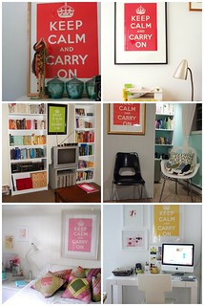
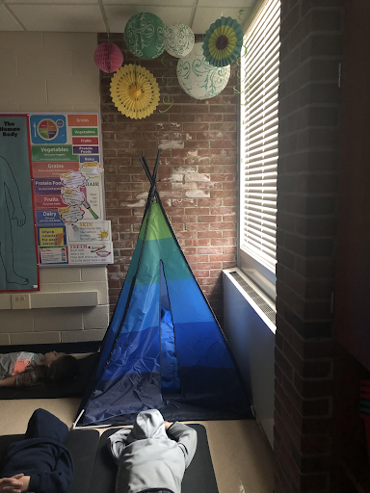
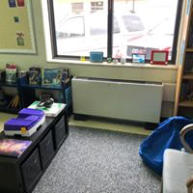
Examples:
Your calming area can be very simple, you just need an area for your student / child to sit and a few calming tool options.
This Photo by Unknown Author is licensed under CC BY

Slide 9
Thank you, enjoy your calming space!

